Slide 1
Supply Chain and Sustainability Management Review
August 27, 2014

Slide 2
Agenda
Purpose
Definitions
Intent and Implementation
Accreditations
Internal and External Audits
Preventive and Corrective Actions
Inter-laboratory Comparisons/Proficiency Tests
Fulfillment of Objectives
Volume and Types of Work
Previous Management Review
Feedback, Complaints, Appeals
Changes Affecting the Management System
Improvements and Action Items

Slide 3
Management Review Purpose
Accreditation Requirement
ISO/IEC 17025, Section 4.15.1 states, “…periodically conduct a review of the laboratory's management system and testing and/or calibration activities to ensure their continuing suitability and effectiveness, and to introduce necessary changes or improvements.”
ISO/IEC 17065, Section 8.5.1.1 states, “… to review its management system at planned intervals, in order to ensure its continuing suitability, adequacy and effectiveness…”

Slide 4
Agenda
Purpose
Definitions
Intent and Implementation
Accreditations
Internal and External Audits
Preventive and Corrective Actions
Inter-laboratory Comparisons/Proficiency Tests
Fulfillment of Objectives
Volume and Types of Work
Previous Management Review
Feedback, Complaints, Appeals
Changes Affecting the Management System
Improvements and Action Items

Slide 5
Definitions
Suitability: adapted to a use or purpose (Merriam-Webster Online Dictionary)
Effectiveness: extent to which planned activities are realized and planned results achieved (ISO 9000, Third Edition)
Adequacy: sufficient for a specific requirement (Merriam-Webster Online Dictionary)

Slide 6
Agenda
Purpose
Definitions
Intent and Implementation
Accreditations
Internal and External Audits
Preventive and Corrective Actions
Inter-laboratory Comparisons/Proficiency Tests
Fulfillment of Objectives
Volume and Types of Work
Previous Management Review
Feedback, Complaints, Appeals
Changes Affecting the Management System
Improvements and Action Items

Slide 7
Intent
UL Environment strives to work with integrity and a strong focus on quality to enhance the trust conveyed by our Certification Marks. With quality as the cornerstone of our technical credibility, we are determined to continually review our quality objectives and improve our services to meet or exceed the expectations of our customers, accreditators and the public.

Slide 8
Implementation
For programs/services where market implications exist and/or customers require accreditations, those programs shall pursue and maintain formal accreditation (17025, 17065, etc.) with an accreditation body;
For programs/services where customers do not require accreditations, those programs shall maintain policies and procedures that comply with applicable standards but are not required to pursue formal accreditation.

Slide 9
Agenda
Purpose
Definitions
Intent and Implementation
Accreditations
Internal and External Audits
Preventive and Corrective Actions
Inter-laboratory Comparisons/Proficiency Tests
Fulfillment of Objectives
Volume and Types of Work
Previous Management Review
Feedback, Complaints, Appeals
Changes Affecting the Management System
Improvements and Action Items

Slide 10
Accreditations
All ULE Labs (Marietta, Cologne and Nansha) are ISO/IEC 17025 – Laboratory Accreditation
ISO/IEC 17065 (previously Guide 65) – Product Certification Accreditation
GREENGUARD has successfully received 17065 Accreditation
BIFMA level program has Audit set up for Accreditation Oct. 7-8.
Main Additions:
Impartiality Committee
Preventive Actions
Procedures and Policies are created to be compliant with and satisfy the requirements set by our Accreditors whether the program is externally accredited or not.

Slide 11
Accreditation and Approvals
PROGRAM | ACCREDITATION(S) / APPROVALS
GREENGUARD | 17065 to certify products, 17025 to test products
BIFMA level | 17065 to certify products, 17025 to test products
BIFMA | 17025 to test products
CARB Ozone | 17025 to test products
CARB Formaldehyde Rule | 17025 to test products*
CA 01350 | 17025 to test products
EPA Formaldehyde Rule | Guide 65 to certify products, 17025 to test products*
CRI | 17025 to test products
USGBC LEED | Guide 65 to certify products, 17025 to test products
BAM | 17025 to test products
DIBt | 17025 to test products
China for China | CNAS and 17025 to test products*
* 2015

Slide 12
Agenda
Purpose
Definitions
Intent and Implementation
Accreditations
Internal and External Audits
Preventive and Corrective Actions
Inter-laboratory Comparisons/Proficiency Tests
Fulfillment of Objectives
Volume and Types of Work
Previous Management Review
Feedback, Complaints, Appeals
Changes Affecting the Management System
Improvements and Action Items

Slide 13
Internal Audits
Aug. 2013 – Marietta - 17025
Nov. 2013 – Nansha – 17025
Nov. 2013 – ECV/SPC - Guide 65
Dec. 2013 – Marietta - OSHA Snap Audit for UL867
Apr. 2014 – BIFMA level and GREENGUARD – 17065
Aug. 2014 – Marietta – 17025
Nov. 2014 – Nansha, Cologne - 17025
Nov. 2014 – ECV/SPC - 17065

Slide 14
External Audits
Sept. 2013 – ACLASS 17025
Oct. 2013 – CRI Process Audit
Dec. 2013 – CARB Desk Audit
Dec. 2013 – DAkkS 17025
May. 2014 – A2LA 17065
Sept. 2014 – ACLASS 17025
Oct. 2014 – CRI Process Audit
Nov. 2014 – ANSI 17065
TBD 2015 – DAkkS 17025

Slide 15
Agenda
Purpose
Definitions
Intent and Implementation
Accreditations
Internal and External Audits
Preventive and Corrective Actions
Inter-laboratory Comparisons/Proficiency Tests
Fulfillment of Objectives
Volume and Types of Work
Previous Management Review
Feedback, Complaints, Appeals
Changes Affecting the Management System
Improvements and Action Items

Slide 16
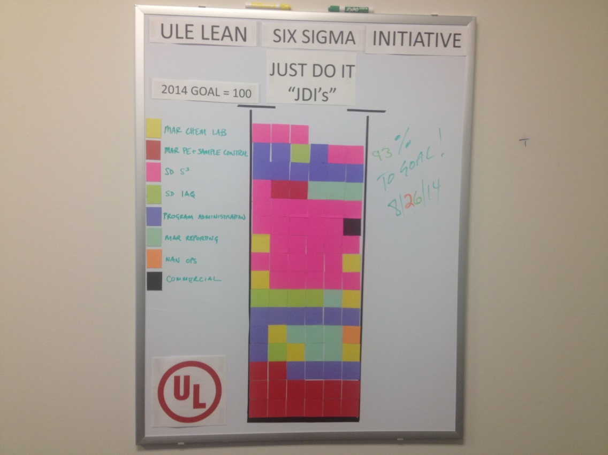
Preventive Actions
Preventive Actions are new to 17065 but have been in place for 17025.
We have had difficulty identifying Preventive Actions. So, we were excited to learn that JDI’s are also a type of Preventive Action.
Preventive Actions (resulting from audits)
Total | In Progress | CLOSED
8 | 0 | 8

Slide 17
Corrective Actions
Type | Total | OPEN | CLOSED
Internal | 44 | 13 | 31
External | 18 | 0 | 18

Slide 18
Agenda
Purpose
Definitions
Intent and Implementation
Accreditations
Internal and External Audits
Preventive and Corrective Actions
Inter-laboratory Comparisons/Proficiency Tests
Fulfillment of Objectives
Volume and Types of Work
Previous Management Review
Feedback, Complaints, Appeals
Changes Affecting the Management System
Improvements and Action Items

Slide 19
Inter-laboratory Comparisons
BAM (Federal Institute for Materials Research and Testing) Round Robin 2014 PRELIMINARY Results
Z-score (± 2 is acceptable)
Location Lab ID | Hexanal | Styrene | n-Decane | 2-Ethyl- Hexanol | Limonene | 1-Methyl-2- pyrrolidinone | 2-Ethylhexyl- acrylate | Dimethyl- phthalate | Hexa- decane
Cologne RR14_26 | -0.3 | -0.4 | -0.9 | -0.2 | -0.4 | -0.1 | -0.5 | 0.0 | -1.1
Cologne RR14_26A | -0.2 | -0.2 | -0.6 | 0.0 | 0.0 | 0.5 | 0.1 | 0.3 | -1.0
Marietta RR14_48 | -0.7 | 0.2 | -0.7 | -0.4 | 0.0 | 0.3 |  | -0.2 | 0.0
Nansha RR14_44 | -0.1 | -0.1 | -0.3 | 0.2 | -0.9 | 0.2 | 0.4 | -1.1 | -1.0

Slide 20
Proficiency Tests
WASP BTEX
Passing Z-Score/Total Number of Z-Scores
Location | Round 1 | Round 2 | Round 3 | Round 4
Cologne | 6/16 | 16/16 | 16/16 | Q4
Marietta | 16/16 | 16/16 | 16/16 | Q4
Nansha | 16/16 | 16/16 | 16/16 | Q4
WASP Formaldehyde
Passing Z-Score/Total Number of Z-Scores
Location | Round 1 | Round 2 | Round 3 | Round 4
Cologne | 4/4 | 4/4 | 4/4 | Q4
Marietta | 4/4 | 4/4 | 4/4 | Q4
Nansha | 4/4 | 4/4 | 4/4 | Q4
Indoor/Chamber Air (21 VOCs)
Passing Z-Score/Total Number of Z-Scores
Location | Round 1 | Round 2
Cologne | * | Q4
Marietta | 52/52 | Q4
Nansha | 52/52 | Q4
Gravimetric Dust
Passing Z-Score/Total Number of Z-Scores
Location | Round 1 | Round 2
Cologne | * | Q4
Marietta | 4/4 | Q4
Nansha | 4/4 | Q4
* Lab not enrolled

Slide 21
Agenda
Purpose
Definitions
Intent and Implementation
Accreditations
Internal and External Audits
Preventive and Corrective Actions
Inter-laboratory Comparisons/Proficiency Tests
Fulfillment of Objectives
Volume and Types of Work
Previous Management Review
Feedback, Complaints, Appeals
Changes Affecting the Management System
Improvements and Action Items

Slide 22
Fulfillment of Objectives
Objective | Measure | Goal | Performance
Quality of Testing | Air Change | 1.0 ACH ± 5.0% | 1.00
 | Mixing | 100 ± 5.0% | 97.8
 | Tightness | < 0.03 ACH | 0.017
 | Recovery | 100 ± 20% | 107.7
 | VOC RSD | < 20% | 11.7
 | Aldehyde RSD | < 20% | 2.23
 | Toluene Recovery | 100% ± 20% | 99.8
 | Rework | < 3% | 4
Timeliness | On-Time Reports | 95% | 97.50
Customer Expectations | Net Promoter Score | To Be Launched Sept. 2, 2014
Lean Sigma | Lean Sigma Trained | 45 | 24
 | Continuous Improvement | 90% | 84%
 | JDIs | 100 | 93
Personnel Capabilities | Employee Training | 40 hrs / Employee | 41.5*
 |  |  | * TBD for some locations

Slide 23
Fulfillment of Objectives
2014 Annual Objectives | Relationship with Quality Programs & Objectives
Sales of 20.4M | Accreditation, Testing Quality, Timeliness, NPS, Training
Improve productivity by 3% | Lean Sigma, Continuous Improvement, JDIs
Break even contribution margin | Lean Sigma, Continuous Improvement, JDIs
Improve customer satisfaction | On-time reports, NPS, Testing Quality, JDIs
Improve employee culture | Training, JDIs

Slide 24
Agenda
Purpose
Definitions
Intent and Implementation
Accreditations
Internal and External Audits
Preventive and Corrective Actions
Inter-laboratory Comparisons/Proficiency Tests
Fulfillment of Objectives
Volume and Types of Work
Feedback, Complaints, Appeals
Changes Affecting the Management System
Improvements and Action Items

Slide 25
Volume and Types of Work
Percent of Revenue

Slide 26
Agenda
Purpose
Definitions
Intent and Implementation
Accreditations
Internal and External Audits
Preventive and Corrective Actions
Inter-laboratory Comparisons/Proficiency Tests
Fulfillment of Objectives
Volume and Types of Work
Previous Management Review
Feedback, Complaints, Appeals
Changes Affecting the Management System
Improvements and Action Items

Slide 27
Management Review 2013
Previous Management Review was performed August 2nd, 2013.
Accomplished
SC&S Management Review SOP
Insight to ULE
Auditing of Non-IAQ Programs
“Re-documenting” of BIFMA level Program
In Process
Creating a fully Compliant Management Review
Document Master List in Quality SharePoint Site
Quality SharePoint Site with Dashboard
Audit Schedule Posted
Document Movement into DCS – 583 Docs total ; 81% moved

Slide 28
Agenda
Purpose
Definitions
Intent and Implementation
Accreditations
Internal and External Audits
Preventive and Corrective Actions
Inter-laboratory Comparisons/Proficiency Tests
Fulfillment of Objectives
Volume and Types of Work
Previous Management Review
Feedback, Complaints, Appeals
Changes Affecting the Management System
Improvements and Action Items

Slide 29
Feedback, Complaints and Appeals
No system set up yet – Multiple CARs have been written against us due to this.
Complaints, moving over to UL System beginning 9/2/14.
Need to analyze customer complaint and feedback data to see what we can do better for the customer or possible customer needs.
Feedback to also come from the Impartiality Committee meetings on an annual basis
Currently no Appeals but need to retain a Spreadsheet to track Appeals.

Slide 30
Agenda
Purpose
Definitions
Intent and Implementation
Accreditations
Internal and External Audits
Preventive and Corrective Actions
Inter-laboratory Comparisons/Proficiency Tests
Fulfillment of Objectives
Volume and Types of Work
Previous Management Review
Feedback, Complaints, Appeals
Changes Affecting the Management System
Improvements and Action Items

Slide 31
Changes Affecting Management System
Any Changes that affect the Management System need to be made known to Quality to ensure there is no compromise to our accreditations.
New Programs – Additional Accreditation or Competency needed?
New Employees – Training Completed?
Other?

Slide 32
Agenda
Purpose
Definitions
Intent and Implementation
Accreditations
Internal and External Audits
Preventive and Corrective Actions
Inter-laboratory Comparisons/Proficiency Tests
Fulfillment of Objectives
Volume and Types of Work
Previous Management Review
Feedback, Complaints, Appeals
Changes Affecting the Management System
Improvements and Action Items

Slide 33
Next Steps Upcoming audits and accreditations
CRI Audit – Marietta – Sept. 10th
ACLASS 17025 Surveillance Audit – Marietta – Oct. 1st
ANSI/BIFMA level 17065 Accreditation Audit – Ottawa – Oct. 7th & 8th
ECV/SPC Internal Audit – Lync Audit – Nov. 17th – 20th
CARB Approval Audit – Desk – Dates not scheduled

Slide 34
Plan Looking Forward
Expansion of external accreditations:
US EPA Formaldehyde Law – Q1 2015
CNAS (China for China) – 2015
17065 Scope Expansion (NSF 336) - 2015
Review and revision of procedures and metrics:
Across all ECV, SPC, and EPD Programs (in process)
Establish a Global Master List of documents on the Quality SharePoint site for easy access by all locations.

Slide 35
Improvements / Action Items
Improvements to the Effectiveness of the Management System
Resources needed?
Other Action Items

Slide 36
Thank You!

